Slide 1
Brain Organization
Similarity among vertebrates
Organization-major features
Development
Structure-Function Relations

Slide 2
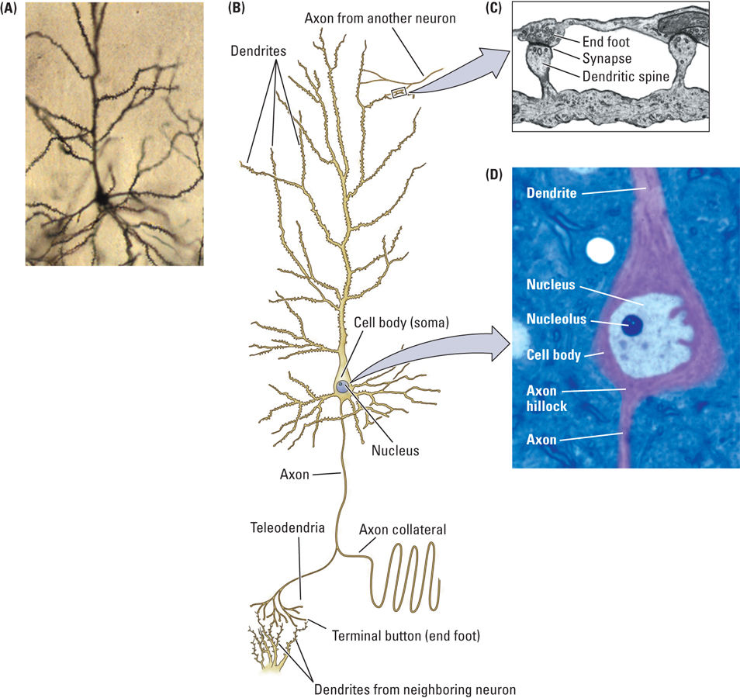
Terminology
nerve/tract
ganglion/nucleus
receptor
cell body (soma)/axon/dendrite/neurite/fiber

Slide 3
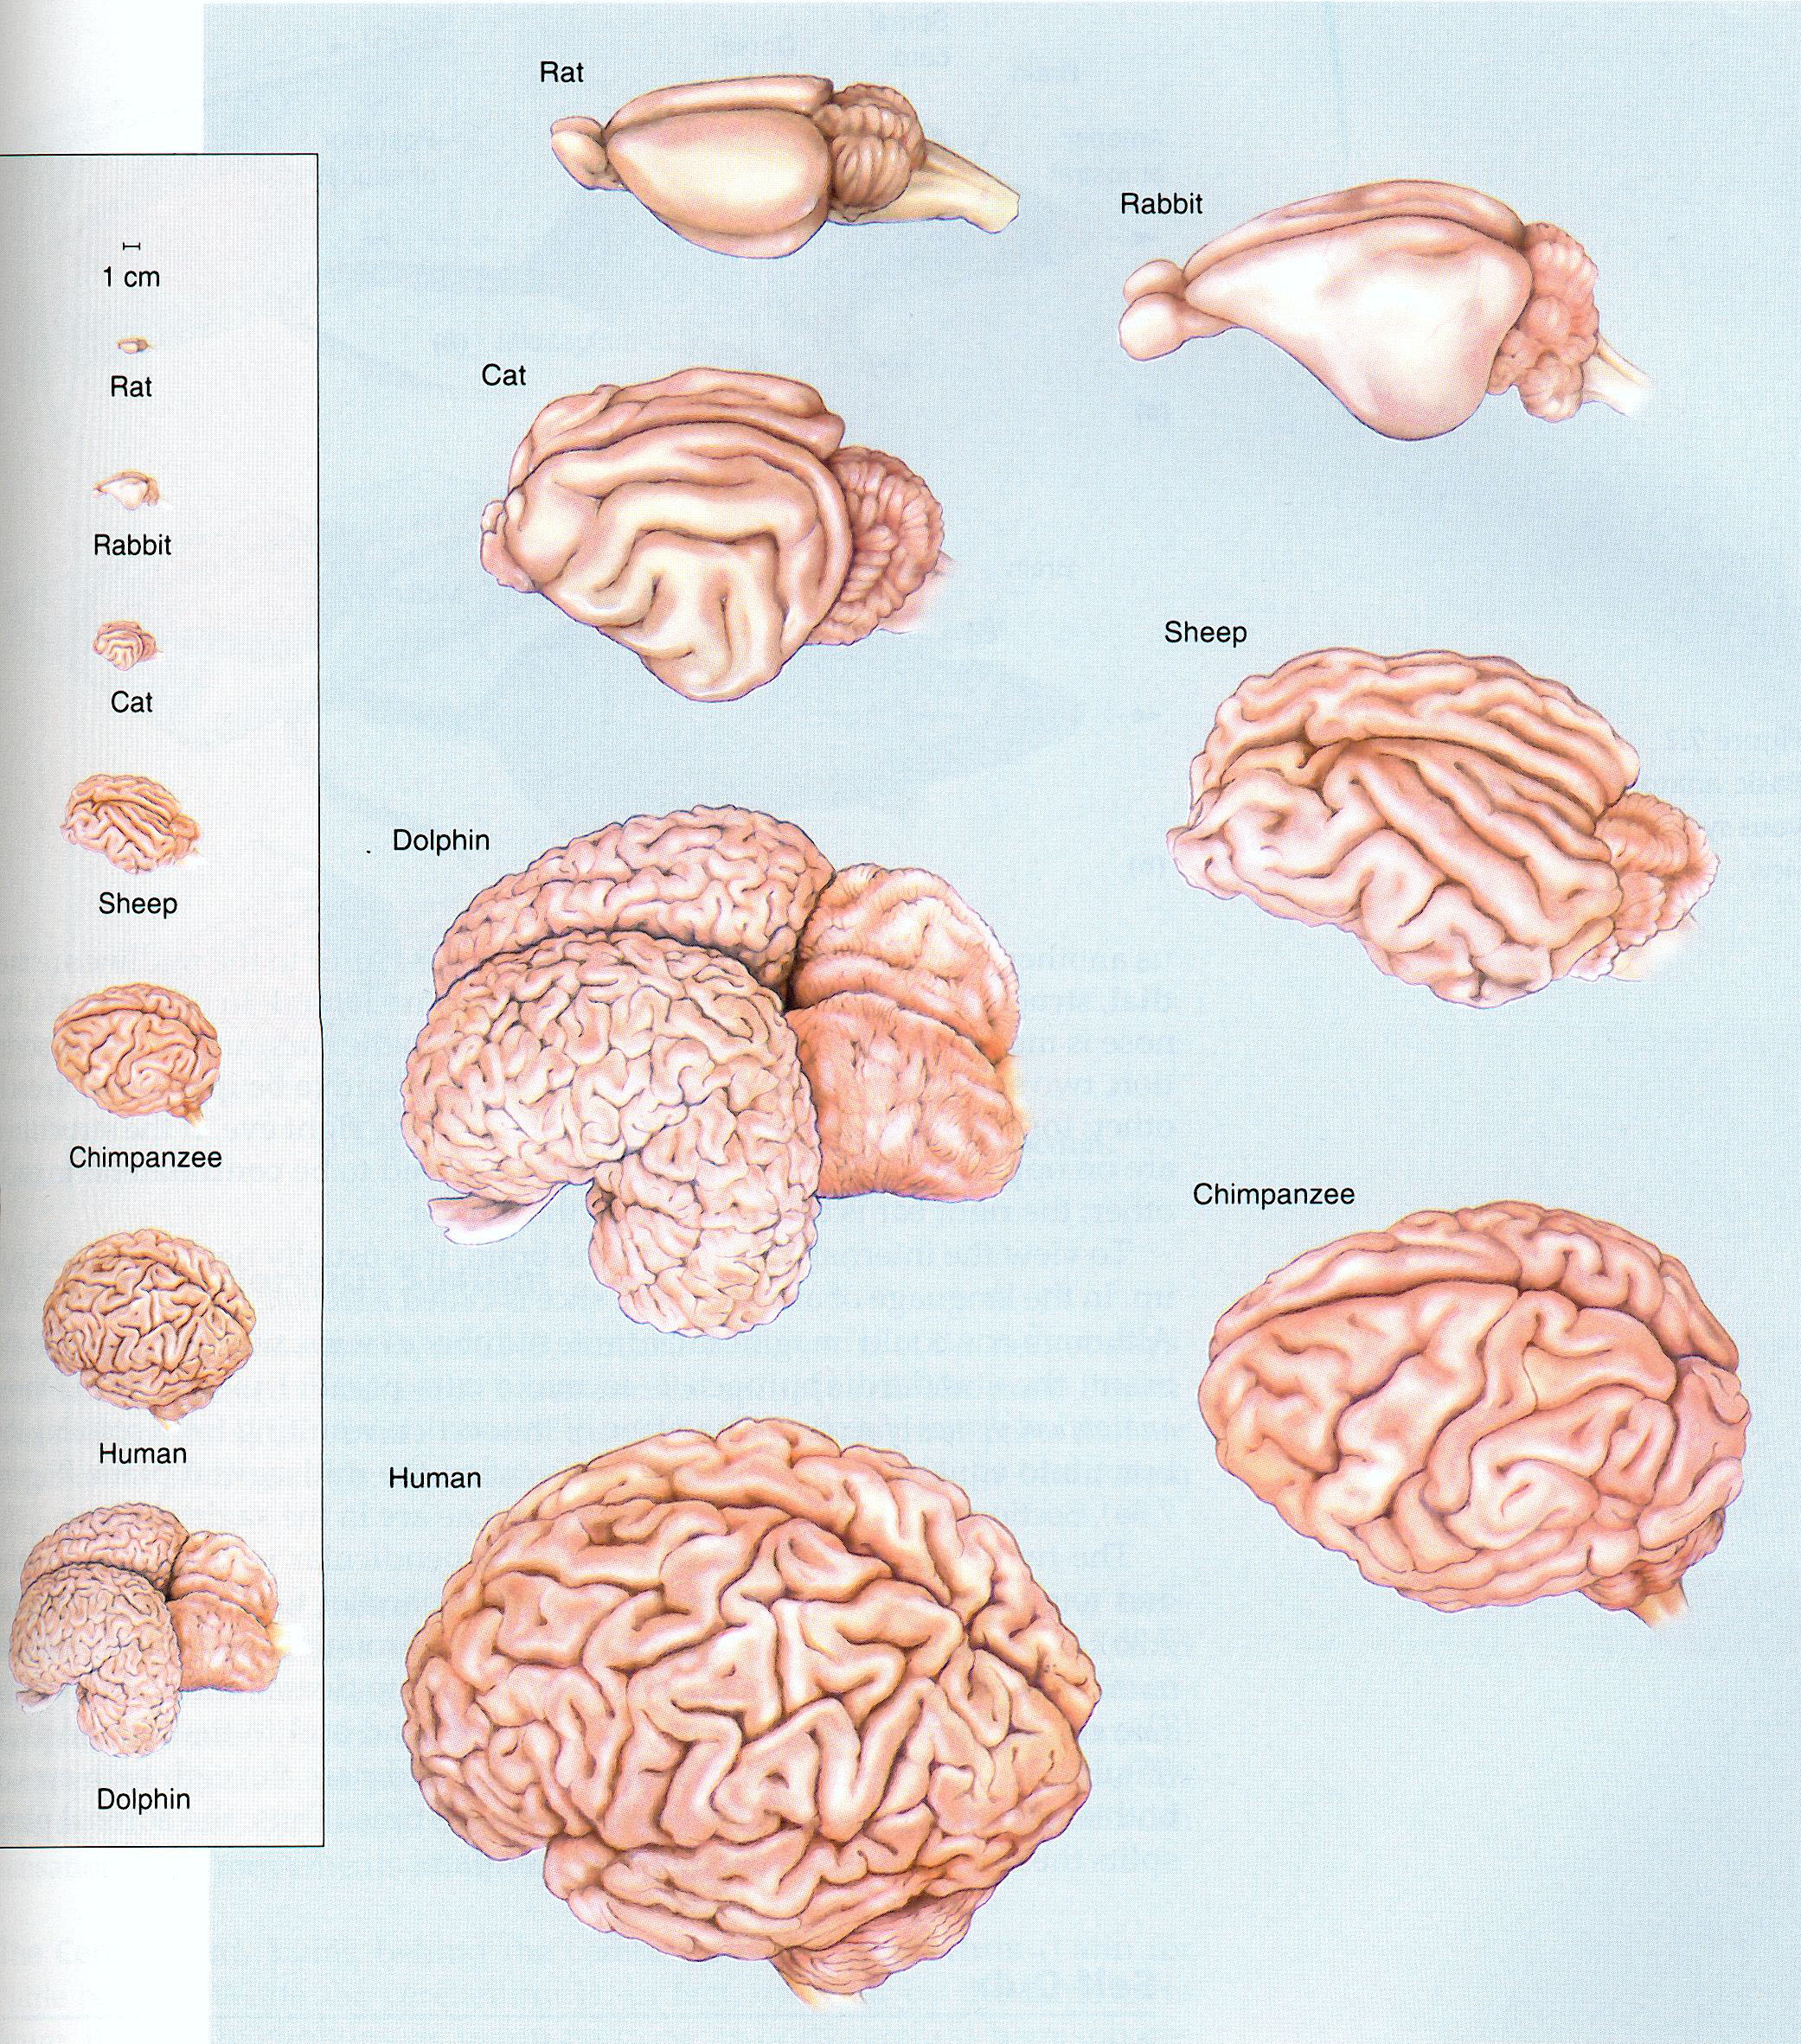

Slide 4
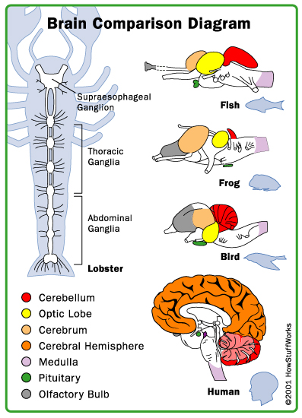
All vertebrates have the same brain components because they share a common evolutionary origin

Slide 5
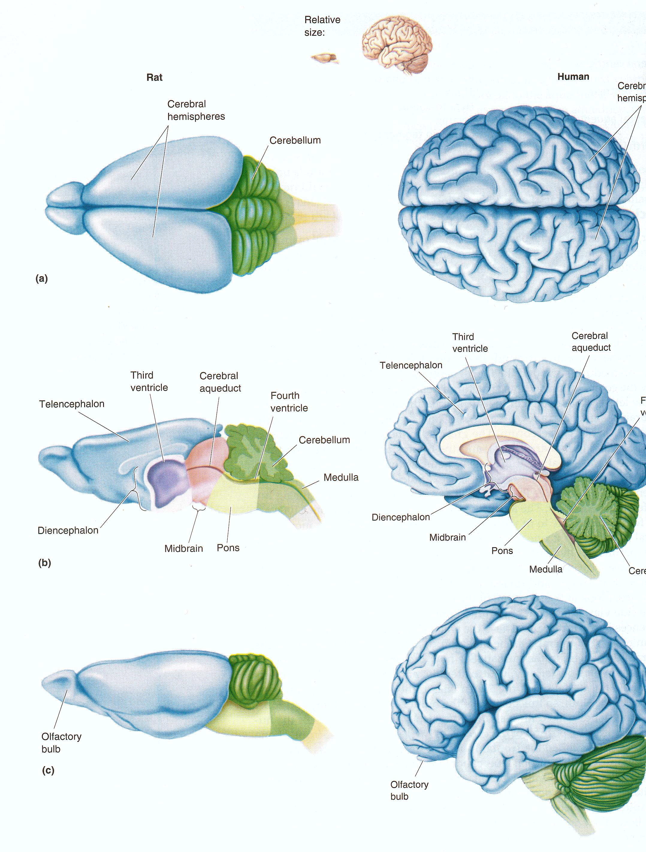

Slide 6
Vertebrate Nervous System Organization
Basal Ganglia

Slide 7
Vertebrate Nervous System Organization

Slide 8
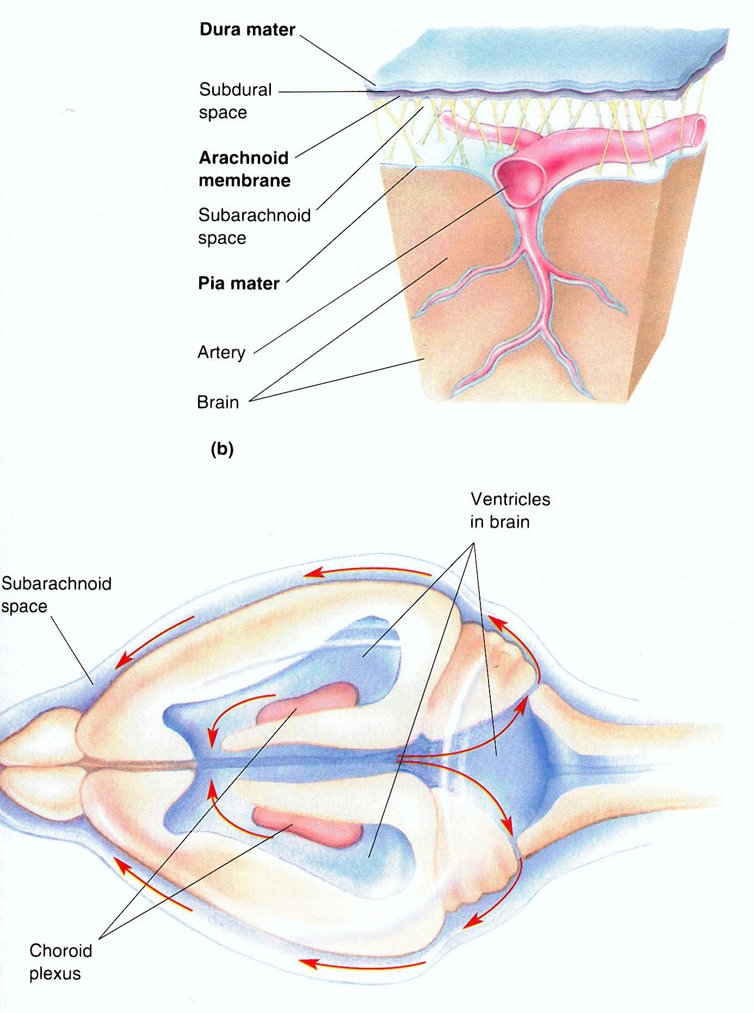
The Ventricular System

Slide 9
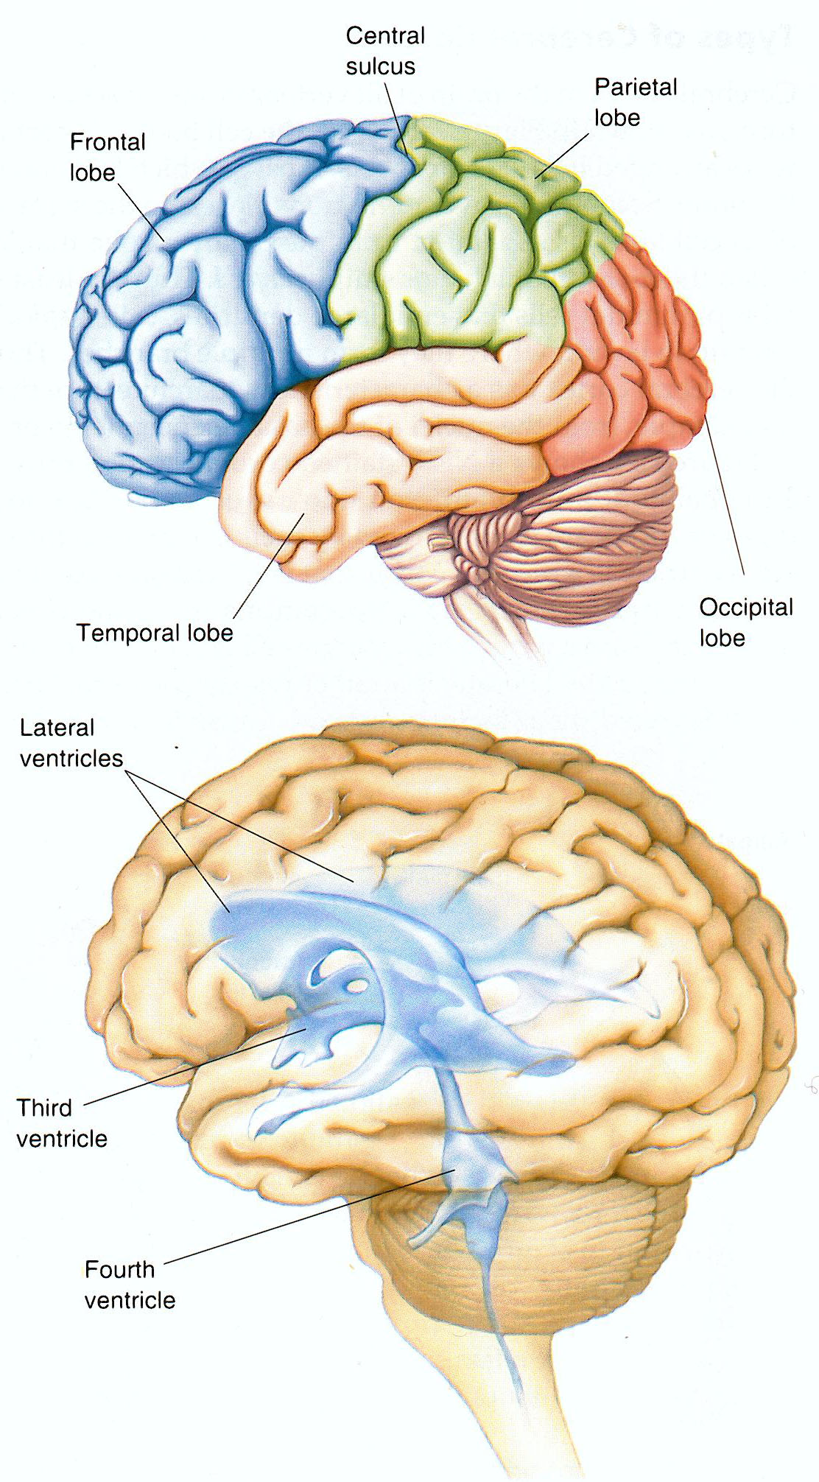

Slide 10
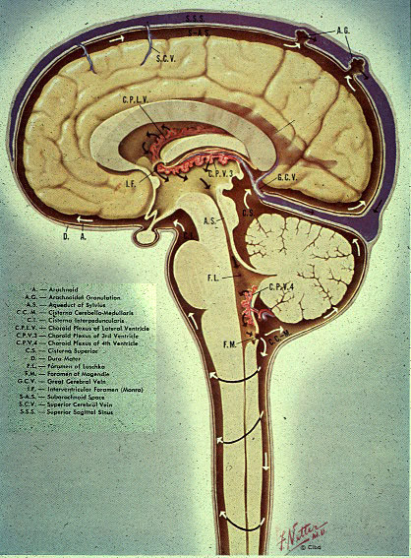

Slide 11
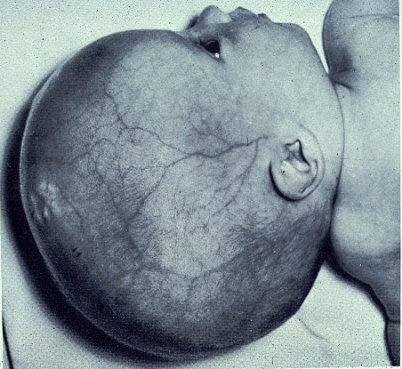
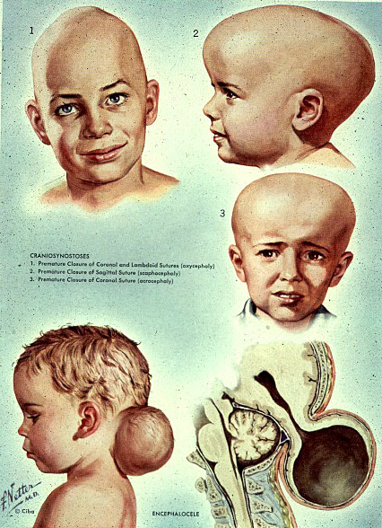

Slide 12
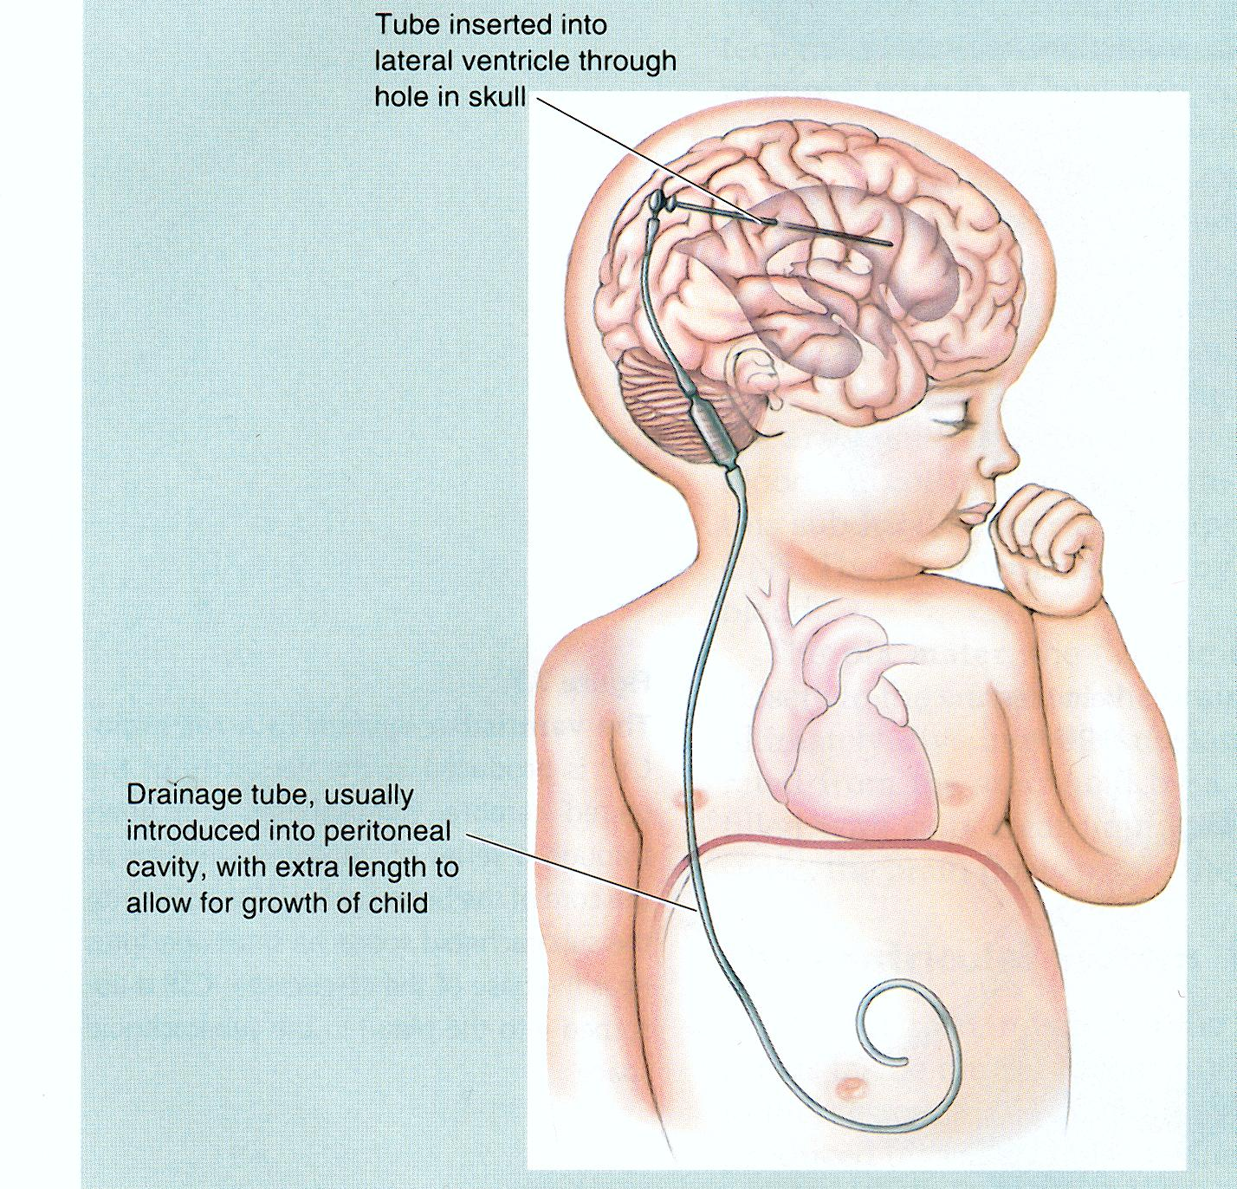
Treatment Of Hydrocephalus

Slide 13
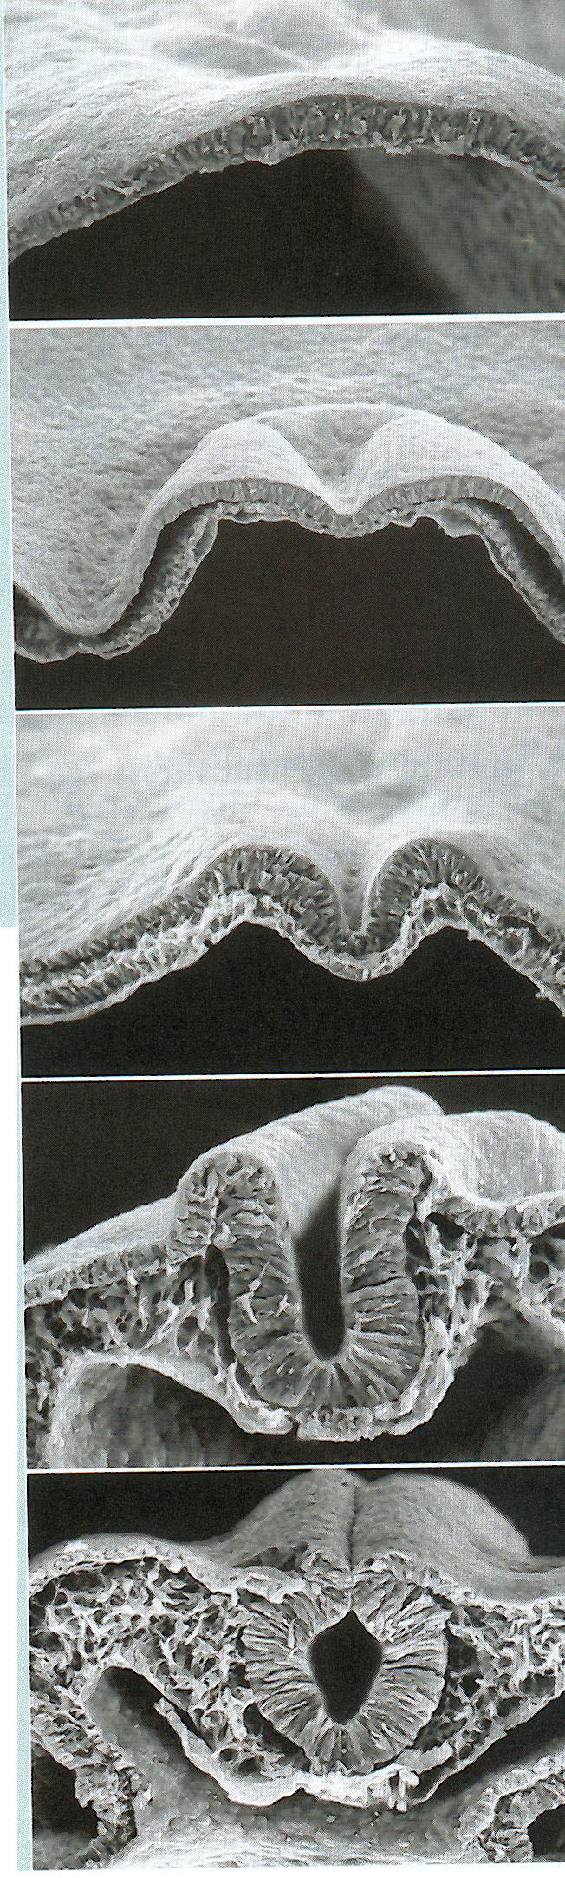
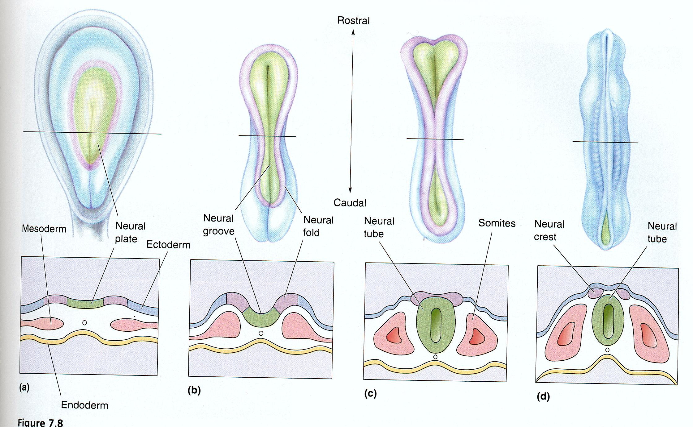
Brain Development

Slide 14
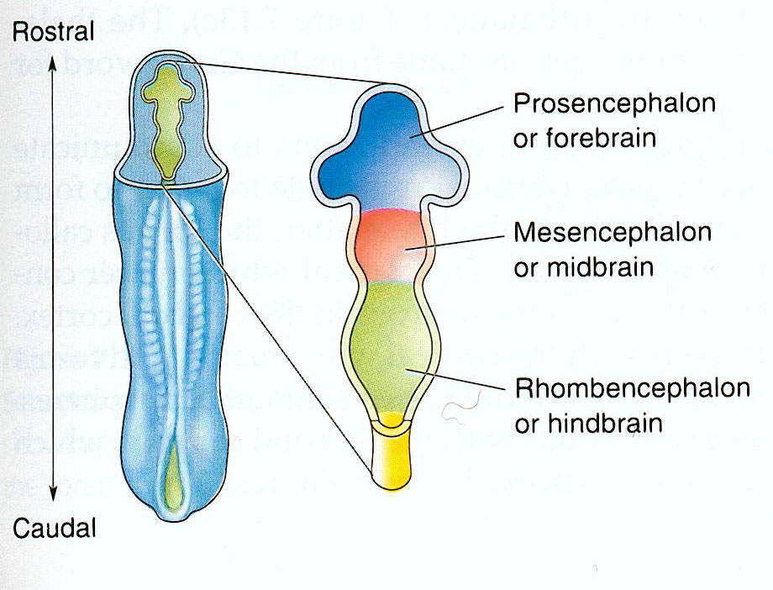
Primary Vesicles

Slide 15
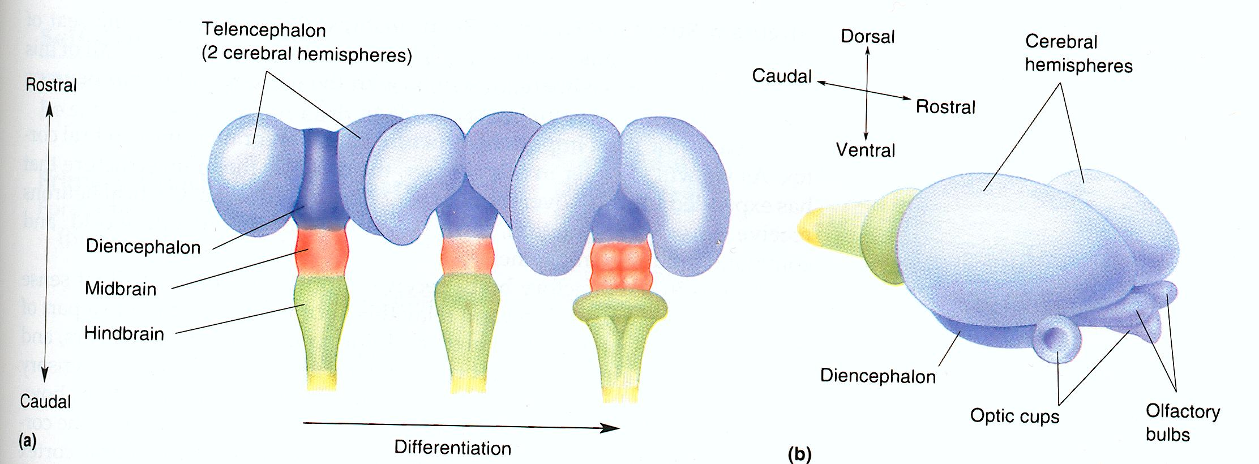

Slide 16
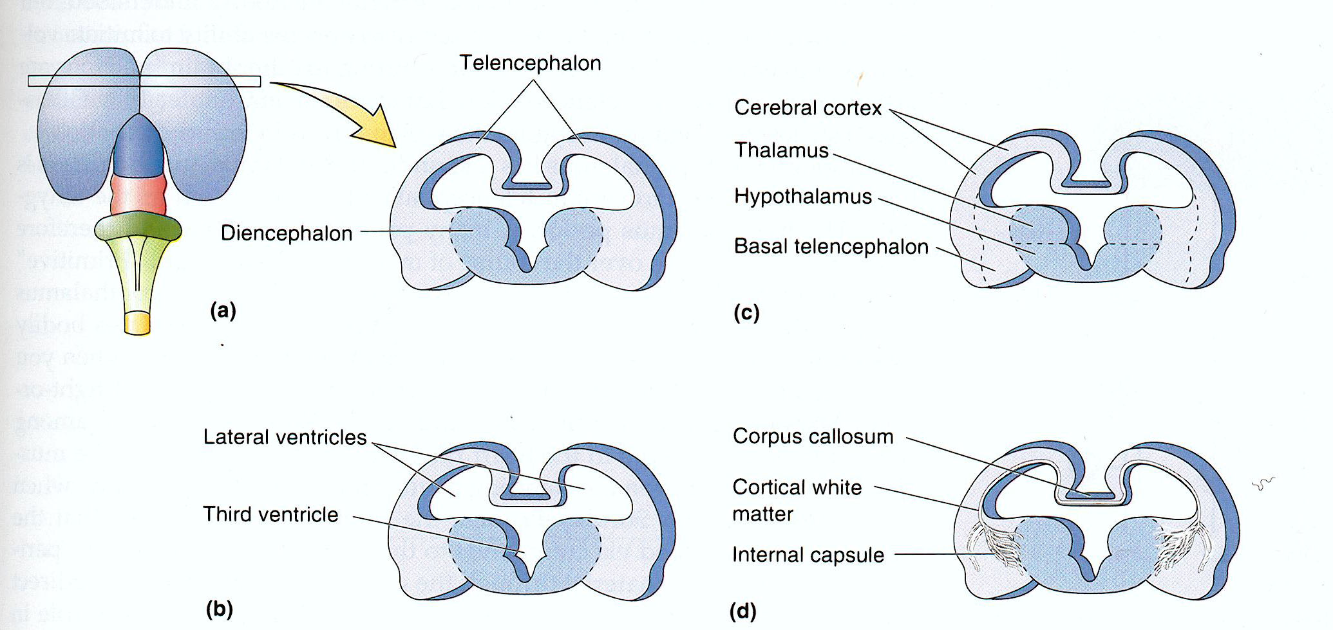
Forebrain Development

Slide 17
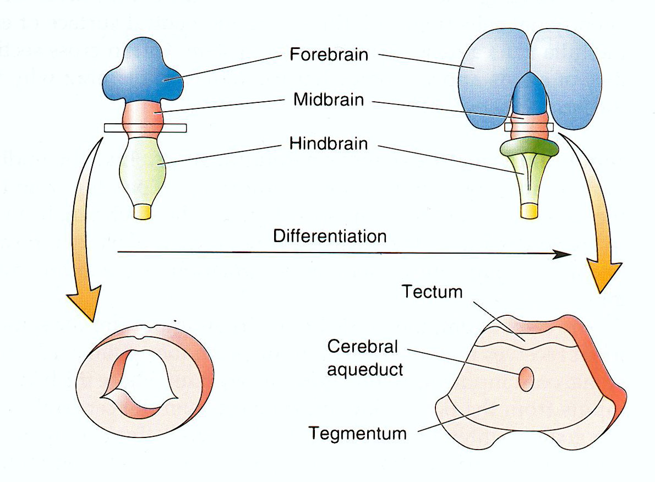
Midbrain Development

Slide 18
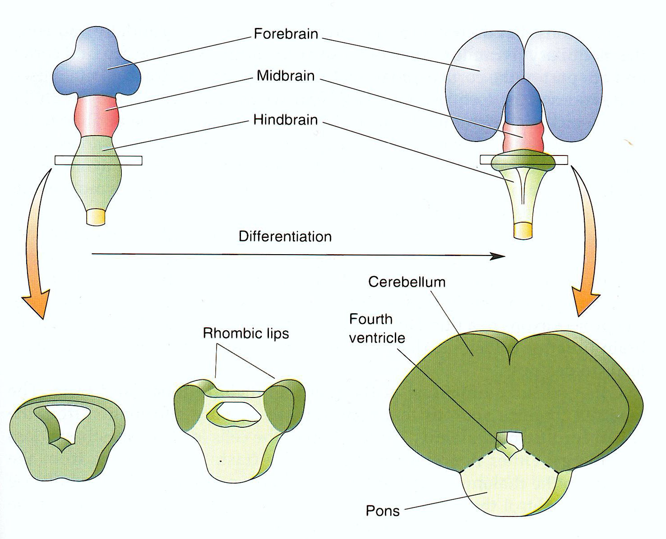
Rostral Hindbrain Development

Slide 19
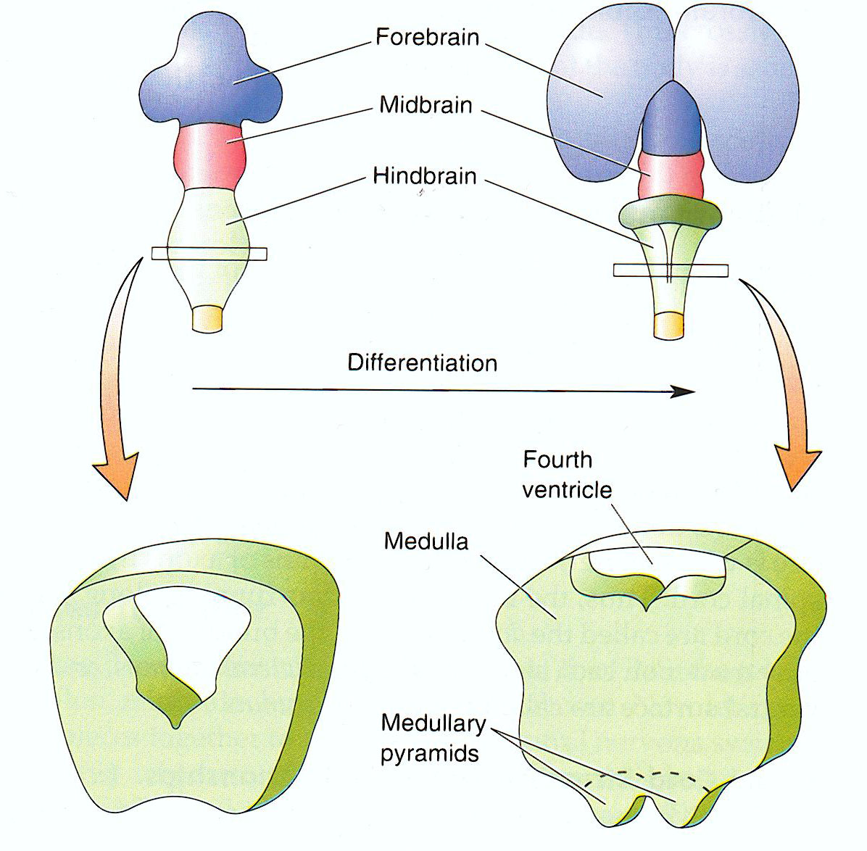
Caudal Hindbrain Development

Slide 20
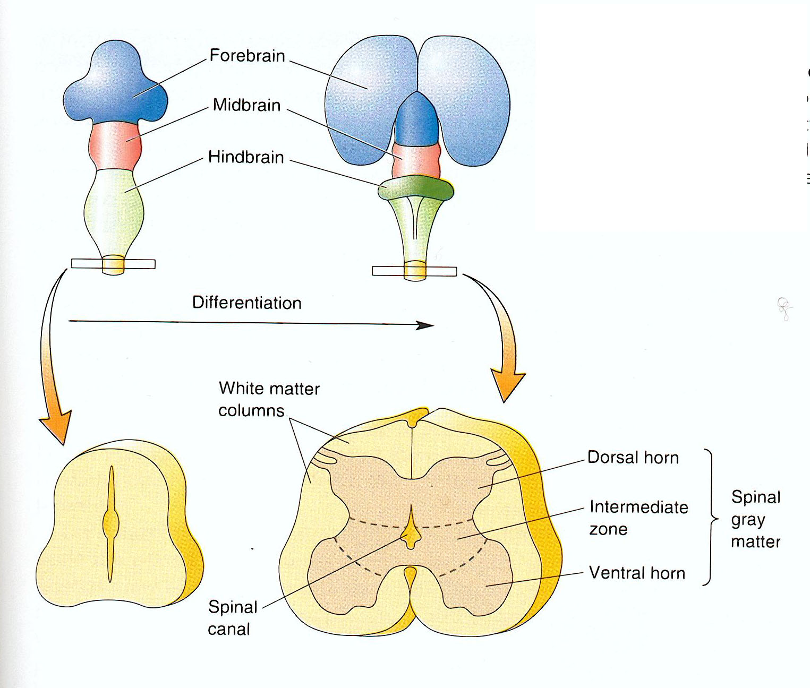
Spinal Cord Development

Slide 21
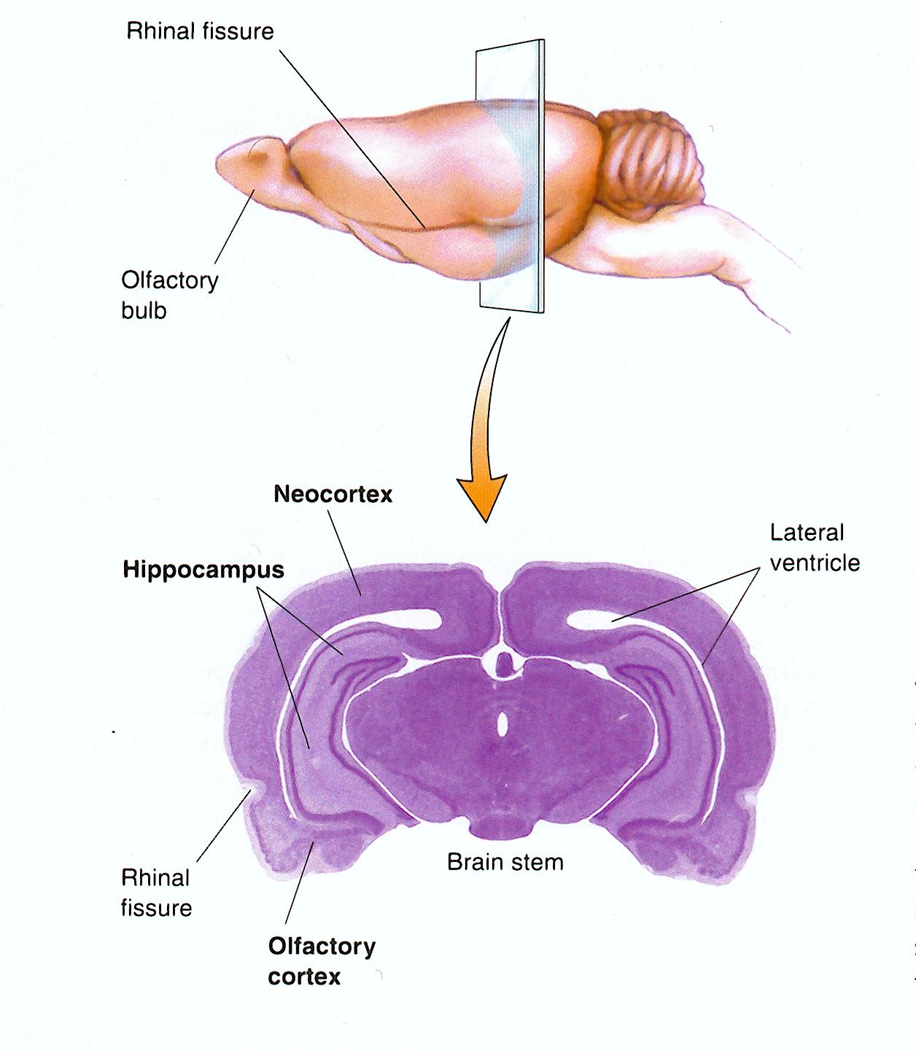
3 Types of Cortex

Slide 23
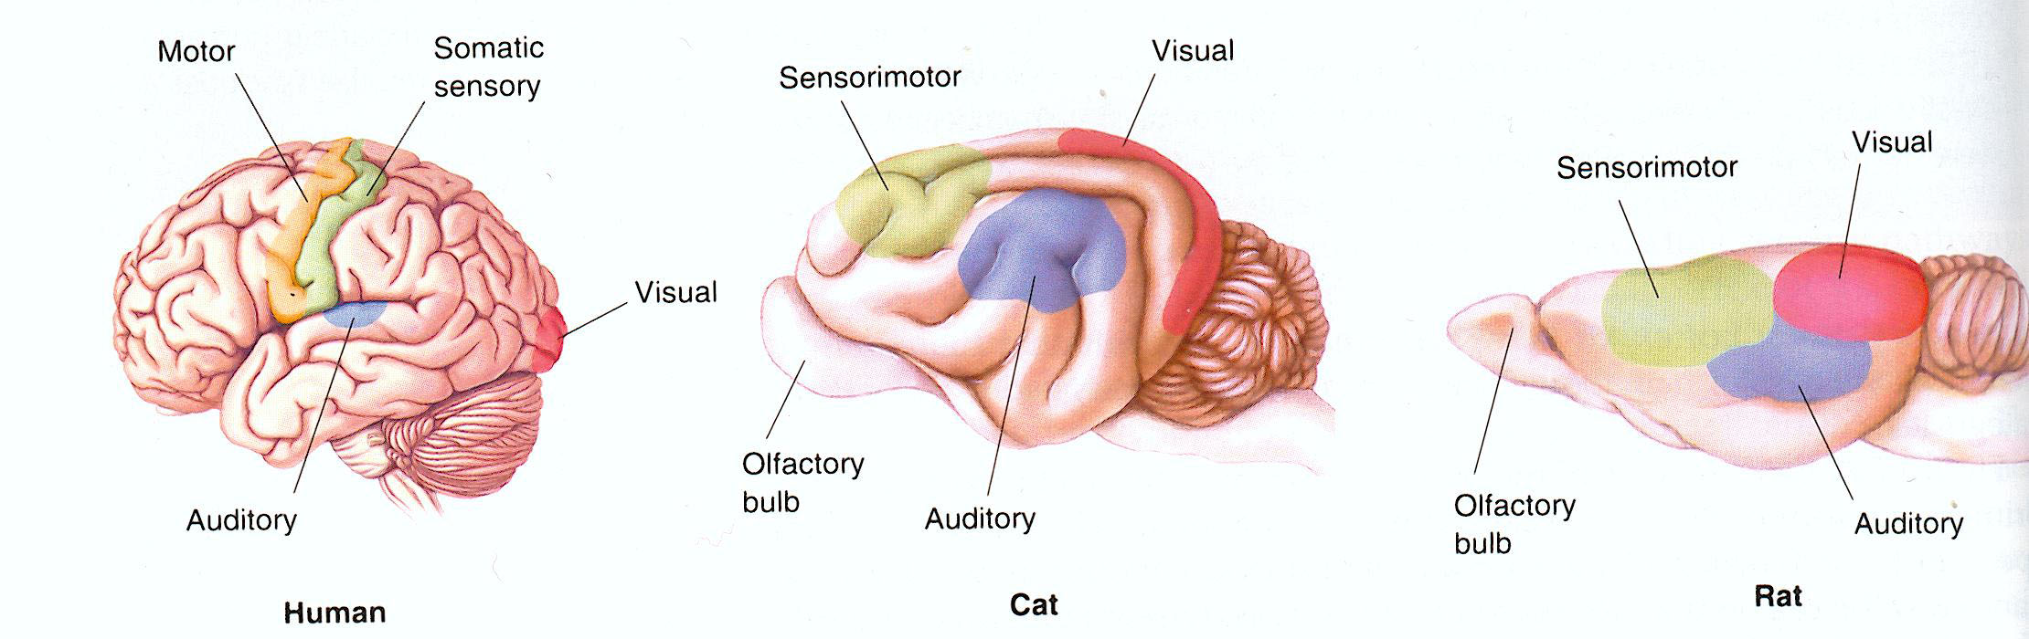

Slide 24
How do we know what we know about major brain regions?
Experimentally induce lesions (non-humans), accidents and neuropathies (humans)
Experimental stimulation
Early work of Wilder Penfield
Imaging
fMRI-functional magnetic resonance imaging
PET- positron emission tomography

Slide 25
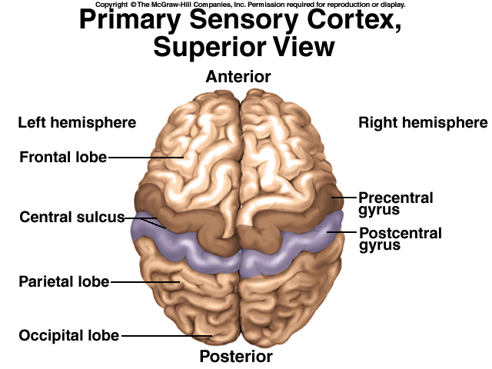

Slide 26
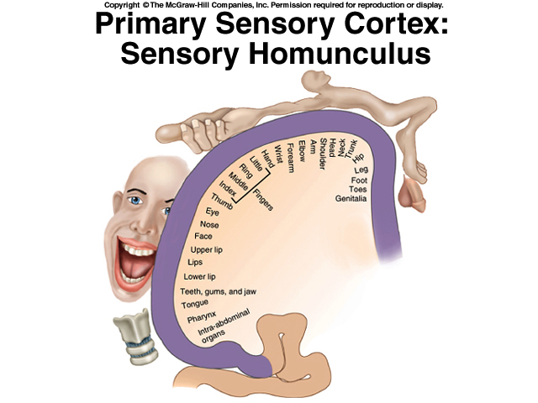

Slide 27
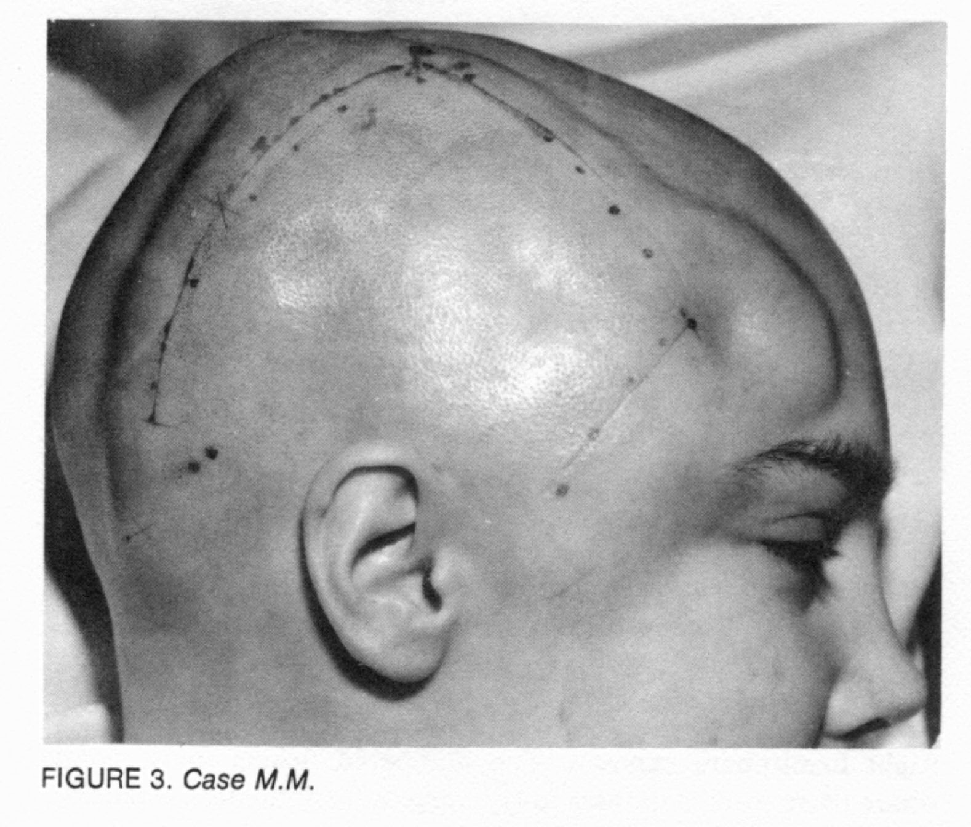

Slide 28
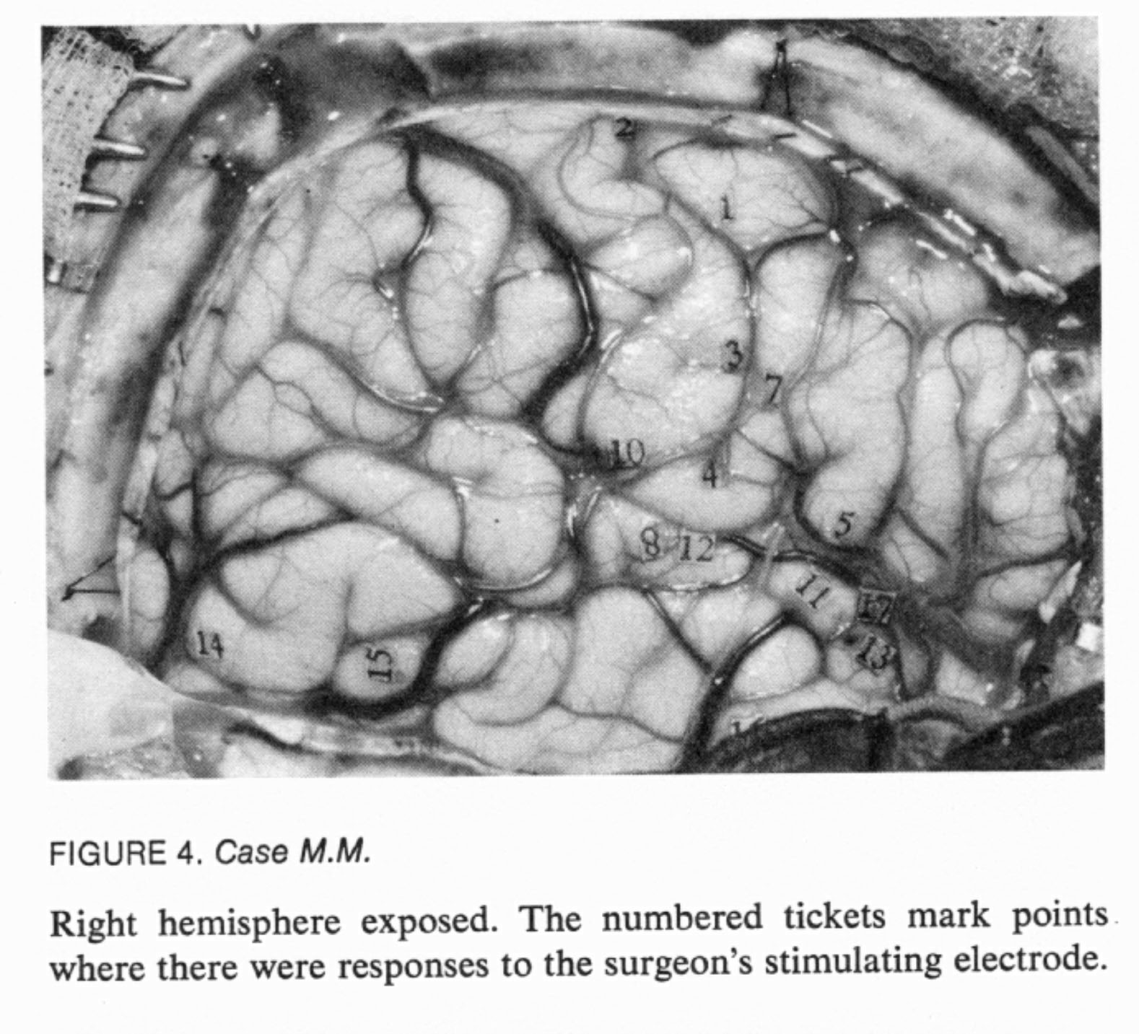

Slide 29
PET – positron emission tomography
-subject is injected with a radioactive form of glucose (F-18 deoxyglucose)
Glucose is taken up by neurons in proportion to their activity
F-18 deoxyglucose accumulates in most active cells
Positrons emmitted by the radionuclide are detected

Slide 30
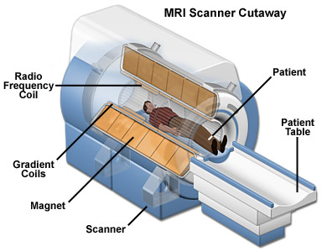
fMRI-functional magnetic resonance imaging
Head is placed in the bore of a very strong magnet
Magnetic field is “pulsed” or varied
Atoms emit radiofrequency energy – this is what is detected
Oxygenated blood emits differently than deoxygenated blood

Slide 31
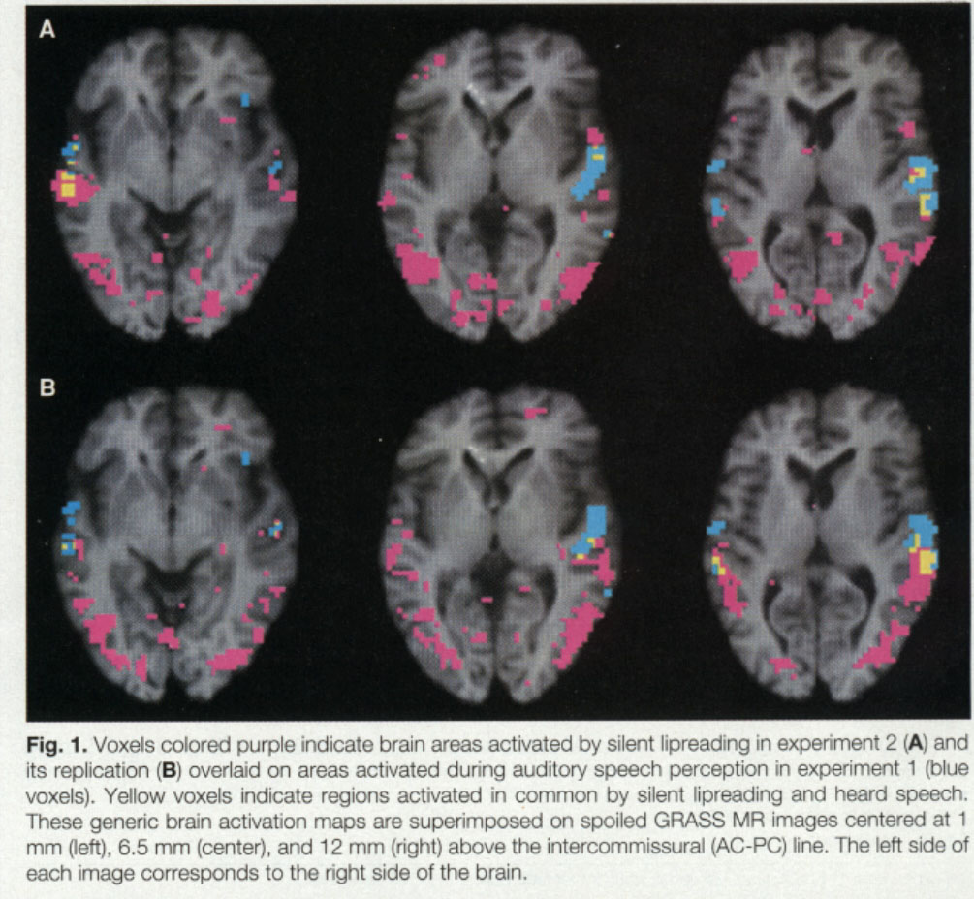
blue=auditory
speech percept.
purple= silent lip reading
Yellow=both

Slide 32
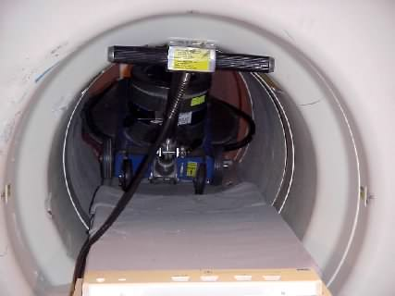
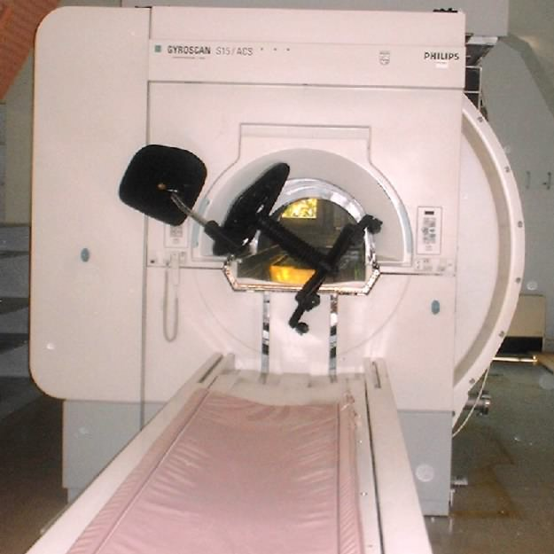
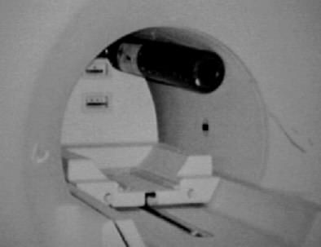
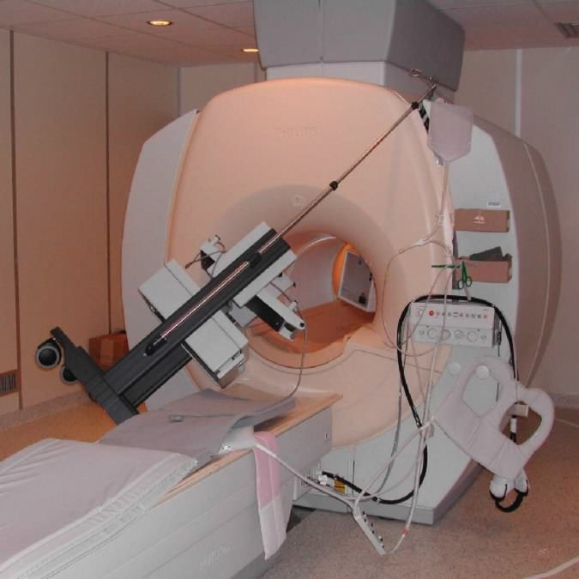
MRI Hall of Shame

